Slide 1

CMU Portugal
Advanced Training Program
Natural Language Processing and Computer Vision
JOÃO MAGALHÃES
NOVA SCHOOL OF SCIENCE AND TECHNOLOGY
ANA CONDEZ
NOVA SCHOOL OF SCIENCE AND TECHNOLOGY
BRUNO MARTINS
INSTITUTO SUPERIOR TÉCNICO
VASCO RAMOS
NOVA SCHOOL OF SCIENCE AND TECHNOLOGY
email: jmag@fct.unl.pt

Slide 2

Documents on the web
In 2010 the amount of data geretad was 2 ZetaBytes.
In 2020 the amount of data generated was 64.2 ZetaBytes.
In 2024, the number of emails is about 361 billion every day.
16 million texts are sent — every minute.
Data creation is predicted to reach 181 ZB by 2025.
https://spacelift.io/blog/how-much-data-is-generated-every-day

Slide 3
Information organization and search​
How to organize your data?​
Data is highly heterogeneous​
Labels are also very heterogeneous​
How to find information?​
User queries are also very heterogeneous​

Slide 4

The Encoder and Its Use Cases
Input: The encoder takes raw text as input and breaks it into tokens (smaller chunks).
Self-Attention: The encoder then processes these tokens, understanding their contextual importance relative to each other.
Output: Finally, it outputs a rich, context-aware representation of the input.

Slide 5
The Encoder and Its Use Cases
Document Classification:
Encodes documents to capture the relationship between words, helping assign labels or categories (e.g., "sports," "business").
Span Extraction:
Helps identify specific spans of text (e.g., answers in a question-answering system) by understanding the context of the query.
Search:
Improves search engines by encoding both the search query and documents, allowing for more relevant matches and better understanding of user intent.

Slide 6
Key Strengths of the Encoder:
Context Understanding:
Understands relationships between all words in a sequence, allowing the model to capture the full context of a text.
Generalization:
Pre-trained transformer models (e.g., BERT, GPT) can be fine-tuned for a variety of specific tasks with high accuracy.

Slide 7


Spam filtering

Slide 8
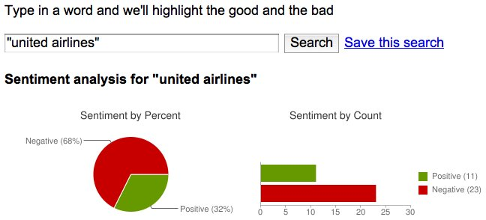
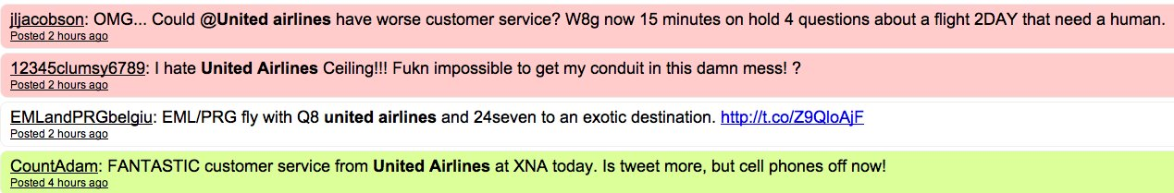
Target Sentiment
Target Sentiment Analysis focuses on determining the sentiment (positive, negative, neutral) expressed in relation to a specific target
The target could be a brand, product, person, or any other entity mentioned in the tweet.

Slide 9
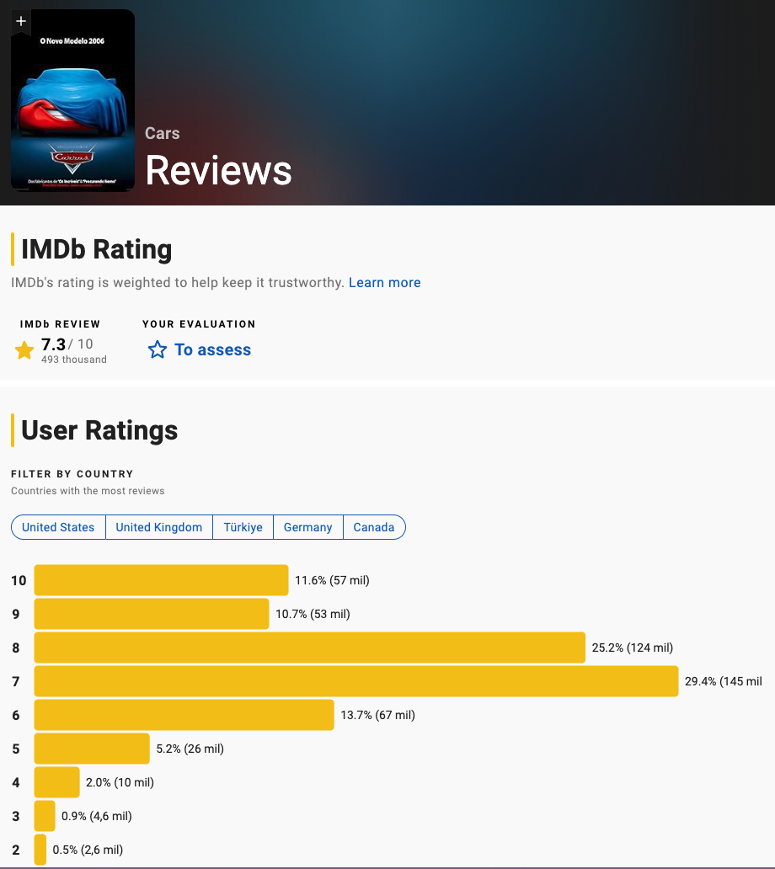
Sentiment Classification in Movie Reviews
Sentiment Classification is the task of determining whether a text expresses a positive, negative, or neutral sentiment.
In the context of movie reviews, the goal is to classify a review based on the overall opinion expressed by the reviewer.
Movie reviews are a rich source of subjective opinions, making them a perfect dataset for sentiment analysis.
Reviews often contain strong expressions of likes or dislikes, which makes it easier to identify clear sentiment.

Slide 10
A very common pipeline
Dataset
Pre-training
Capture “World Knowledge”
Fine-Tuning

Slide 11
A very common pipeline
Expensive
Multi-task training
Train Full-Architecture
Specific
Dataset
Pre-training
Capture “World Knowledge”
Fine tune
Less expensive
Single-task training
Add or train a specific layer to the architecture
Enormous
Dataset

Slide 12
How to capture general knowledge?
Pre-Training

Slide 13

BERT
It is a fine-tuning approach based on a deep Transformer encoder
The key: learn representations based on bidirectional context
Pre-training objectives: masked language modeling + next sentence prediction

Slide 14
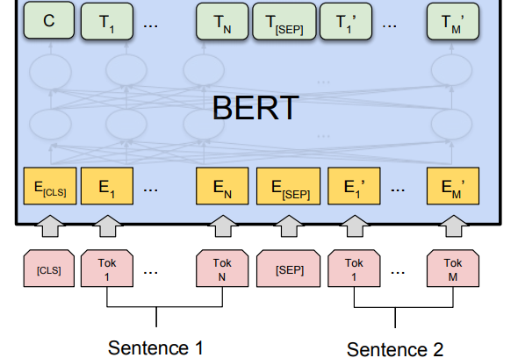
BERT
It is a fine-tuning approach based on a deep Transformer encoder
The key: learn representations based on bidirectional context
Pre-training objectives: masked language modeling + next sentence prediction

Slide 15
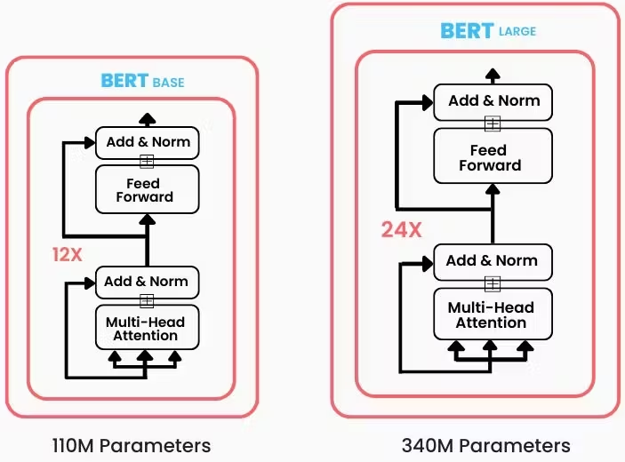
BERT Size & Architecture

Slide 16
What is Pre-training?
Pre-training is the initial phase where a model learns general knowledge from a large, diverse dataset.
The model is trained on massive text corpora (e.g., Wikipedia, books, or web articles) to understand basic language patterns, structures, and semantic relationships.

Slide 17
Masked Language Model
Learning Contextual Relationships
In natural language, a word’s meaning is heavily influenced by the surrounding words.
Masked Language Modeling (MLM) helps the model learn these relationships by predicting masked words based on their context.
Bidirectional Understanding
MLM allows the model to understand a word’s meaning by considering both its left and right context, providing a deeper, more complete understanding.

Slide 18
Masked Language Model
Randomly mask tokens
<CLS>
Just
<MASK>
it
<SEP>
Tokenize and Mask
Input
Just do it

Slide 19
Masked Language Model
try
5%
make
20
Use the output of the masked word’s position to predict the masked word
do
70%
finish
5%
Prediction Head
<CLS>
Just
<MASK>
it
<SEP>
BERT
<CLS>
Just
<MASK>
it
<SEP>

Slide 20
Next sentence prediction
Next Sentence Prediction (NSP) is a task where a model predicts whether a given sentence logically follows another sentence.
NSP helps models develop contextual understanding by capturing the relationship between consecutive sentences.

Slide 21
Next sentence prediction
is_next
92%
not_next
8%
Prediction Head
This token learns to represent the meaning of the entire sequence and can be used to classify it
<CLS>
Speed
<SEP>
I
am
speed
<SEP>
BERT
<CLS>
Speed
<SEP>
I
am
speed
<SEP>

Slide 22
Next sentence prediction
Understanding Sentence Relationships: Many downstream NLP tasks, like Question Answering, document classification, and information retrieval, require the model to understand how sentences are connected.
Grasping sentence relationships allows the model to correctly assess if one sentence logically follows another.

Slide 23
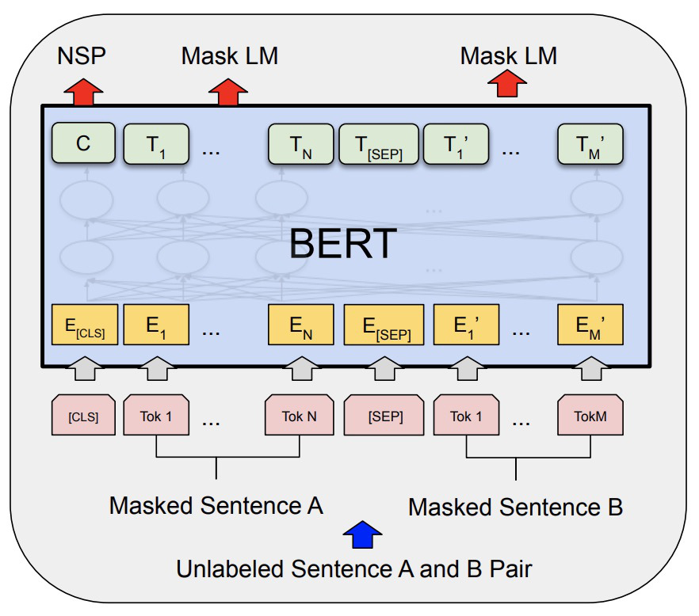

Slide 24
Fine-Tuning
The pre-trained model has already learned general language representations, so fine-tuning allows you to specialize this knowledge for a particular problem without starting from scratch.

Slide 25
Fine-Tuning: Recipe
Pre-trained Weights:
Start with a model that’s been pre-trained on a large, general dataset
Task-specific Dataset
Fine-tune the model using a labeled dataset relevant to your task
Adjusting Layers:
Feature Extraction: Small Updates on the weights
Task-Specific Layers: Additional layers specific to the task are added

Slide 26
Fine-Tuning Tasks
Document Classification
Classify documents into categories (e.g., “news”, “sports”...)
Named Entity Recognition
Locate and classify named entities mentioned in unstructured text
Span Extraction
Retrieve specific spans of text as answers to questions
…

Slide 27
Document Classification: Sentiment Analysis
Good
92%
We introduce a classification head
that outputs if a sentence is good or bad
Bad
8%
Class Head
CLS
T₁
T₂
T₃
T₄
T₅
BERT
The movie was really great
Single Sentence

Slide 28
Document Classification: Sentiment Analysis
Sentiment analysis is a type of document classification where the goal is to determine the sentiment (e.g., positive, negative, or neutral) expressed in a piece of text.
It’s commonly used to analyze reviews, social media posts, or customer feedback to understand public opinion or user sentiment about a product, service, or event.
Example: Classifying a movie review as “positive” or “negative.”

Slide 29
Document Classification: NER
Company
80%
We introduce a classification that can recognize named entities
(Named entity recognition)
Fruit
10%
Person
2%
Entity Head
…
CLS
T₁
T₂
T₃
T…
BERT
Apple will launch the new iPhone in september
Single Sentence

Slide 30
Document Classification: NER
Named Entity Recognition (NER) is a task where the model identifies and classifies key entities in a text into predefined categories such as:
Persons (e.g., “John Doe”),
Organizations (e.g., “Google”),
Locations (e.g., “New York City”),

Slide 31
Span Extraction
2016
Encoder
When did Portugal win the Euro?
Portugal win the Euro in 2016
Question
Answer

Slide 32
Span Extraction
Span extraction is a task where the model identifies and extracts specific spans (sub-sections) of text from a document in response to a query.
In span extraction, the model is trained to predict two positions:
Start position: The beginning of the relevant span.
End position: The end of the relevant span.

Slide 33
Span Extraction in Real World
“John Doe is a Data Scientist at ABC Corp. He has a Master's degree in Computer Science from XYZ University and 5 years of experience in machine learning and data analysis.”
BERT
How many experience does the candidate have?
What is the candidate's current job title?
What degree does the candidate hold?

Slide 34
Span Extraction in Real World
Automated CV Parsing: HR systems can automatically extract and organize key information from CVs.
Streamlining Recruitment: By using span extraction, companies can quickly identify relevant candidate information, making the recruitment process more efficient.
Job Title: Data Scientist Degree: Master's in Computer Science Experience: 5 years
BERT
Question <SEP> Curriculum Vitae <SEP>

Slide 35
Search
Retrieve relevant documents or passages in response to a query.
Traditional methods (e.g., TF-IDF) rely on keyword matching, but BERT-based models go beyond by understanding the semantic meaning of both the query and the documents.
BERT models enable semantic search, where the meaning of a query is matched with the meaning of the documents.

Slide 36
Approaches for Document Retrieval
We need to find and rank documents that are most relevant to a user’s search query.
The system should retrieve documents based on how well they match the user’s intent and the content of the query.
Approaches with the Encoder:
Cross Encoder
Dual Encoder

Slide 37
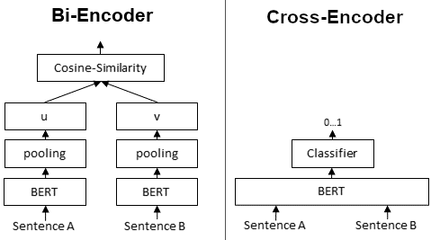
Cross-Encoder
Query and the Document are processed together.
Query and Document are fed through BERT to produce a single relevance score.
The model produces a relevance score based on the output from the [CLS] token—a summary representation of the entire input sequence.
Input structure:
<CLS>SENTECE A<SEP>SENTENCE B <SEP>

Slide 38
Dual Encoder
In the Dual Encoder approach, the query and document are encoded separately by two BERT Models
Each encoder generates a vector representation (embedding) for the query and the document independently.
The similarity between the query vector and document vector is calculated (e.g., via dot product or cosine similarity) to determine relevance.

Slide 39
Advantages
Cross-Encoder
Dual-Encoder
High Accuracy:
Analyzes interactions between all words in the query and document.
Effective for Complex Queries:
Merges query and document in the same encoding for a deeper understanding of relationships.
Fast and Scalable:
Independent encoding enable precomputing of vectors.
Efficient for Large Datasets:
Ideal for systems with millions of documents where speed is critical

Slide 40
Disadvantages
Cross-Encoder
Dual-Encoder
Computationally Expensive:
Processes every query-document pair together, slowing down searches for large datasets.
Not Scalable:
Best suited for re-ranking after an initial document retrieval, not for large-scale searches.
Lower Precision:
Query and document are encoded separately, leading to a loss of details.
Less Contextual Interplay:
Doesn't capture fine-grained word-to-word interactions.

Slide 41
Use Cases
Cross-Encoder
Dual-Encoder
Re-ranking:
After fast retrieval, re-rank top results for higher precision.
Question Answering & Short Document Retrieval:
Ideal for tasks requiring a detailed understanding of the query-document relationship.
Large-Scale Document Retrieval:
Perfect for large-scale search systems where speed is essential.
Retrieving Top-N Candidates:
Quickly retrieves top-N candidates
Results can be re-ranked by a Cross Encoder for higher accuracy.

Slide 42


Search
BERT
Search query
Query
embedding vector
Compute Similarity
BERT
Search results

Slide 43

Thank you!

